Slide 1


AViDD NSP13 Chem Updates
Anwar H. | Kesate A. | Peter B. | Tim W.
SGC-UNC
https://go.unc.edu/avidd-chem
Updated: Jan 09, 2023

Slide 2
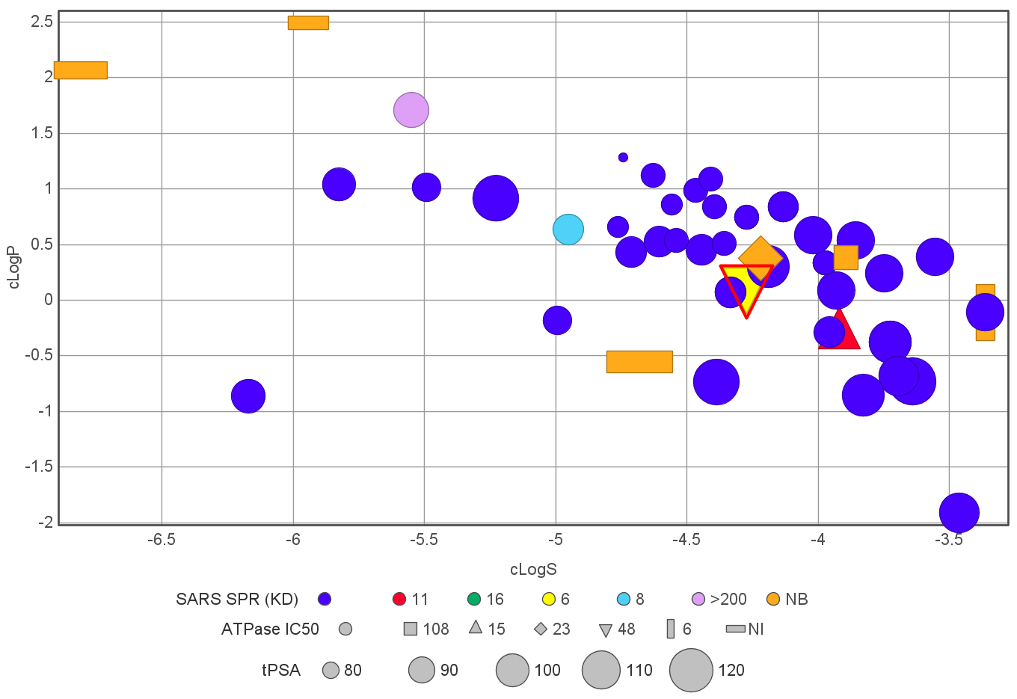
Enamine REAL 51 N-Oxide Analog Stats
Analogs purchased and screened: 51
N-Oxide contains: 51
Active in SPR: 4 (<20 µM)
Active in ATPase: 4 (<100 µM)
Active in the antiviral assay: None
cLogP < 3
cLogS -6.0 to -3.5; good soluble
51 N-Oxides: cLogP vs cLogS

Slide 3
Rationale of N-Oxide analog design
#1: We already screened 51 N-Oxide and more in process from generative library; 4 of them showed some activity
#2: Polarity is high which may limit the compounds cell permeability
#3: Improve solubility window with optimum cLogP (increase logP without changing chemotype)
#4: To explore the diverse functionality
#5: Explore synthetic flexibility
Parameter | Values
MW | 346.41
cLogP | 0.148
cLogS | -4.27
tPSA | 124.79
Solubility (µM) | 179.48* (75% dose)
Solubility (µg/mL) | 62.17* (75% dose)
RA-0001264-01
SPR CoV-2 (6 µM), MERS (5 µM)
NSP13 ATPase IC₅₀ = 48 µM
Inactive in antiviral assay
X-tal is pending

Slide 4
SAR Plan for RA-1264
Modification/replacement of thiazoles
Purpose:
Structural simplification (?)
Explore diverse substitution
Map the activity trend
Flip the left and right acids
Replacement of N-oxide
Replacement of cyclobutyl

Slide 5
SAR of RA-1264 @ UNC
RA-0001264-01
No N-O
Reverse order
Reverse order
Making library of 10 analogs at UNC
Strategies:
Simple chemistry
Accessible building blocks
Diverse set
Making common building blocks to expand at the last step
Kesate

Slide 6
Campaign#05: Generative Library
Total target: 5
Status of the library:
Intermediate RAC-36-1K delivered
Generative Compounds
Synthesis in process:
RAC-36-2 Completed
RAC-36-1, -3 in process
Control Compounds (removal of N-oxide)

Slide 7
